Slide 1
Using Subversion for Source Code Management
James Leinweber
Wisconsin State Laboratory of Hygiene
Notes:
confession: I am not one of the world’s ultimate experts on subversion.
However, I did pick it for the WSLH, have read several of the books, configured it, and trained our IT staff on using it. So I speak to you from a position of reasonable knowledge and experience.

Slide 2
outline
about source code management and the WSLH
  why SCM, cultural issues, why subversion
about subversion in general
  clients, repository topology, IAA, project lifecycle, …
  branching and merging
some subversion experience
  quirks, managing Linux, good/bad/ugly, quick start
subversion in action
  screenshots and/or live demo
    GUI: TortoiseSVN, RapidSVN, subclipse; command line: svn, svnadmin
Notes:
we will not try to recapitulate the entire books on the subject, but we will drastically shorten your learning curve.
you should end able to decide if subversion is a good choice for your shop,
and be able to rapidly set up an R&D environment if you want to experiment

Slide 3
What is source code management?
roughly, tools for tracking multiple versions of files over time
  developers track evolution of source code
  system administrators track configuration files
basic capabilities
  check stuff in
  check stuff out (current version, or any historical one)
  tag sets of files as a particular release
  resolve conflicting changes using some merging tools
examples
  RCS, CVS, Perforce, bitkeeper, git, visual sourcesafe, …
Notes:
icebreaker: who has used SCM? anyone not?

Slide 4
Why have source code management (SCM)?
document state of a system and rationale for changes
coordinate simultaneous deployment of multiple changes to complex systems
allow reversion to previous versions in case of problems
ease sharing code on multi-developer projects
facilitate code audits
business continuity - speed system re-creation
compliance (CAP, Sarbanes-Oxley, PCI-DSS, …)
Notes:
While SCM is more or less required for developers, it is also quite helpful for system administrators.
Is everyone convinced?

Slide 5
about the Hygiene Lab
Wisconsin’s public health laboratory since 1903
  performs about 1000 clinical, environmental and industrial tests
    metabolic disorders in neonates, rabies, TB, STDs, atrazine in ground water, mercury and PCB’s in fish, radiation monitoring of nuke plants, cytology, asbestos in workplaces, …
  Wisconsin liaison to federal CDC; major customers include state DHFS, state DNR, federal OSHA, Montana, Kuwait, …
  administered in the Center for Health Sciences at the UW
    but has a separate board of directors and line in the state budget (unusual)
  budget is about $35M/year, roughly 350 staff
IT at the Hygiene Lab
  recently centralized (summer ’05)
  about 10% of the staff (given workload, should be 13%)
  in 2006, about 15% (!) of the budget
Notes:
Hygiene Lab is on the bleeding edge of lab technology, not computer technology.

Slide 6
creating a change control culture at WSLH
historically …
  dispersed developers worked independently on small projects
… but not any more
  internal incentives
    centralized IT, java web portal, bigger projects, more interagency dataflows, more cross-training
  external regulatory compliance pressures
    PCI-DSS (also WI identity theft statute & UW-Madison response)
    State continuity of operations initiatives
    College of American Pathologists certification
SCM needs management support
  and has it
slow work: training, migration, and customs
  our ex-chemists turned programmers had never used any SCM
  neither had most of our windows sysadmins
  3+ legacy SCMs in some existing projects to migrate
  still evolving good project layout practices to share
    my mantra: “do whatever makes sense, but avoid gratuitous incompatibilities”
Notes:
As my grandfather used to say, “It’s good for what ails you, and if nothing ails you, it’s good for that too”. He wasn’t talking about SCM, but it still applies…

Slide 7
SCM: from many alternatives …
commercial
  SCCS, CMVS, Perforce, Clearcase, pvcs, bitkeeper, visual sourcesafe …
open source
  RCS, CVS, subversion, git, monotone, arch, bazaar, …
filter by WSLH SCM major goals
  network repository, for use from multiple buildings
  one tool for everyone, developers and sysadmins
    need clients for Linux, Windows, Eclipse
  handle binary as well as text objects
  also desirable, but not necessary:
    ease of use, low overhead, low cost, open source, GUI interfaces
Notes:
Given the importance to our field, SCM has a long history, dating back to systems based on punched cards in the 1960’s.

Slide 8
… Hygiene Lab chose subversion
project started in 2001 to improve on and replace CVS
  Can rename files and directories without losing history
  versions properties and directories as well as files
  does atomic binary commits of entire directory trees
  repository is a DB, not a tree of archives of file objects
has enough clients for most of us
  Windows, Linux, Mac OS-X, Eclipse, emacs, …
    command line & GUI, on all platforms
  optional web interface (via Apache and webDAV)
is gaining traction
  free source (Apache style license), with active development
  increasing adoption by major projects:
    KDE, GCC, Apache, Samba, CUPS, Python, Gnome, …
Notes:
We may have been the first large scale user at the UW-Madison.
… but we were late to the SCM party; we don’t have a legacy CVS infrastructure

Slide 9
what did we deploy?
server
  svnserve on Linux (listens on port 3690/tcp)
    Using the FSFS backend (not the Sleepycat DB backend)
    didn’t bother with the web interface
    platform:
      slightly boosted the spec’s on an incoming DB server for another project
      +1 CPU, +1GiB RAM, +100GB disk = way overkill
clients
  Linux: svn (command line)
  Windows: TortoiseSVN (GUI), svn (command line)
  Eclipse: subclipse (GUI)

Slide 10
topology of subversion
a server hosts one or more repositories
  svnadmin create /path/to/all/repositories/thisone
  access by file (on host, e.g. ssh to svnserve tunnel mode), svn network protocol (if svnserve is running), or webDAV (if Apache + module is running)
a repository contains one or more projects
  just a top level directory, really
  typically created by svn import …
convention: a project should have 3 standard subdirectories
  trunk
    hosts the main line of development
  branches
    each subtree is for separate lines of development or patching
    version 1.0.X, version 2.0.X, version 2.1.X, Bob’s weird idea, …
  tags
    for naming point-in-time snapshots (just don’t commit to them!)
    release candidate 1, 1.0.0, 1.0.1, 2.1.5, …
put whatever tree of stuff you are versioning under trunk
  typical client URL svn://server/repository/project/trunk/whatever

Slide 11
Identification, Authentication, Authorization (1)
subversion is simplistic and standalone on IAA
  which is low overhead, if you can tolerate it
identification: by subversion user name
  no prompt if anonymous access mode
  client caches this by default
  we just used our standard WSLH login names
authentication: password/cookie, or strong
  can require TLS client certificate or SSH pubkey
    by not running svnserve as a daemon. use inetd or tunnel mode …
  default is by password
  clients want to cache password (plaintext) – let them
  passwords can only be changed by a repository administrator
  (WSLH: e-mailed machine generated passwords to the IT staff)
Notes:
WebDAV IAA is based on whatever Apache is requiring.

Slide 12
Identification, Authentication, Authorization (2)
authorization
  anonymous or authenticated
  read or write
    default is anonymous read, authenticated write
  per repository (can be shared)
    WSLH: authenticated only, both read and write, shared across 3 repositories
as of v1.3 (January 2006): groups
  mod_auth_svn group policy file was extended to file access
  read/write permissions can differ, by group, by subtree
repository administrator
  any local OS account writing the DB files & configuration files
  3 configuration files: conf/{svnserve.conf, passwd, authz}
Notes:
WebDAV IAA is based on whatever Apache is requiring.

Slide 13
oversimplified project lifecycle
import directory subtrees to create projects
  could pre-populate with lots of file objects, if you have them already
check out stuff
  an empty directory becomes a Working Copy
  entire project, or just some trunk or branch subdirectory tree
work
  edit existing files
  add new or delete old or rename files and directories (using SVN tools, not OS tools)
update (to sync working copy with repository)
  resolve any merge conflicts
commit your changes, with a descriptive message
Notes:
Highlighted in red {import, add, update, commit} are some subversion client actions.
If you do an OS delete of an object, the next update will bring it back.

Slide 14
under the hood
files and directories can be annotated: svn propset …
  with name=value properties, both standard and user-defined, mostly versioned
your working copy includes two and a half of each object
  your local working copy files
  plus each working subdirectory gets a special .svn directory
    update refreshes the .svn file and property data from the repository
server repository and client .svn data is opaque binary stuff (DB!)
  manipulate via the subversion toolchain only
    svnadmin, svnlook, svndumpfilter, svn
  with FSFS backend, each commit is 2 more files (properties, tree diffs)
code base is modern: strongly layered, highly modular
  repository API’s encapsulate back ends
  client API’s encapsulate transport, authentication, and SCM actions
  OS portability courtesy of the Apache runtime libraries
Notes:
commit anywhere in a working copy sends the entire subtree of pending changes from there down.
the .svn files allow you to work independently of the repository (e.g. on a laptop), but it’s not a true distributed SCM
if you are going to have 30,000 revisions, the FSFS backend will create 60k files – use sleepycat DB in that case!

Slide 15
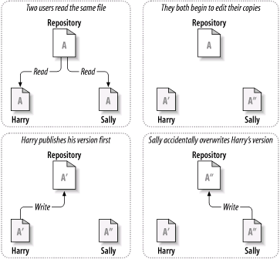
SCM (and DB): the simultaneous edit problem
Notes:
A single user can make good use of SCM to version files, tag production releases, revert mistakes and so on.
But if multiple users are involved, bad things can happen – as in any DB.

Slide 16
subversion solution: copy-modify-merge
check out a working copy and make changes
update
  pulls changes from repository
  flags any merge conflicts (3 files per conflict: yours, theirs, result)
resolve all merge conflicts (by hand)
  using the Merge tools and context menu actions
  you can keep yours, keep theirs, or mix and match the changes
commit
  if the repository version is newer than your working copy, aborts automatically
  the network traffic is the diffs (generated locally) + the commit message
this works very well on simple source text files
  Like opportunistic locking in DB – changes rarely overlap
this is subversion’s default method
  look ma - no locks!
Notes:
There are multiple possible solutions to the simultaneous edit problem. Subversions default doesn’t involve locking, because they want to support disconnected operation.

Slide 17
alternate solution: lock-modify-unlock
why: an alternative method for binary blobs
  where simultaneous edits will conflict, and no merge tool exists
request a lock (on a particular file)
tool warns on checkout if someone else holds a lock
make your changes
commit prevented if your working copy lacks the lock token
  if you have multiple working copies, only 1 of yours can hold the lock
  default: releases 100% of all your working copy locks on any commit
Subversion (as of v1.2 in ’05) supports this too
  permissive by default: anyone can break any lock
    unless you instantiate some of the server hook scripts to enforce things
  use svn:needs-lock property to encourage locking (read-only checkout )
Notes:
note that locks are not a substitute for talking to your team members about what changes are planned

Slide 18
branching for beginners: svn copy
to make a new branch (or tag):
  pick a remote subtree (trunk?) and revision number (HEAD?), use svn copy to give it an extra remote name
    context operations in repository browsers do this too
  underlying objects (files, directories, properties) are not touched
    very cheap: it’s a single DB entry, not a deep copy
your working copy can be a mixture
  you can pull different files from trunk, tags, and various branches
  you can mix changes from specific revision ranges into a file using a merge tool.
rationale for project structure as trunk, branches, tags
  move/rename is currently implemented as copy + delete
switch followed by update mutates working copy branch
  but not between repositories. And will delete “extraneous” files.
Notes:
wake up; the most important and subtle thing you need to know is being discussed!
a side effect of switch + update is that the result is similar to checking out a fresh copy of the new branch. Objects not in the new branch will be deleted! If you aren’t expecting that, you can lose local work. (Obviously anything committed to the repository is permanently available, even if deletion makes it less visible.)

Slide 19
merging for beginners: conflicts, joins, blame
identify merge conflicts by svn status
  or TortoiseSVN GUI feedback
  commits fail until 100% of merge conflicts are resolved
default merge tool manipulates 3 (of 4) files, by lines
  your working copy, their different version, the combined result
  buttons let you step forward and back to differences, and pick which goes into the result
merge tool also helps join branches back to trunk
  pull a range of changes (diff), apply to a working copy file (patch)
    commit comments to branches specify rFROM-rTO, so you know what to ask for.
blame tool shows provenance – all versions in one object
  by line, annotates with committer and version number (can be slow)
  dual to a repository browser (shows all objects at one version) (fast)
Notes:
you can set a binary property to prevent the attempt to generate a merged result
the different version is neither yours not the BASE. If you didn’t change, the update would just overwrite the pristine working copy with the repository’s new version. If the repository didn’t change, BASE is still current, and nothing happens until commit.
future versions of subversion will eventually improve the merge support.

Slide 20
a few subversion quirks
revision number is per-repository
  not per file, nor per project
imports and checkouts take only the subdirectories
  so add an extra dummy parent level
  you can add individual objects (svn cp, or side effects from svn update)
you can’t go from an import to a working copy
  checkout only into empty directories, the import tree has to be deleted
“svn co” means check out, not “svn commit” (aka “svn ci”)
clients are cross-platform, but EOL conventions aren’t
  properties are your friend: svn:eol-style = native, LF, CR, CRLF
archaic VB.NET / visual studio tools choke on .svn
  as of v1.3, substituting _SVN for .SVN is a supported kludge

Slide 21
WSLH sysadmin example: Linux servers
3 repositories: development, support, junk
3 kinds of projects in support repository
  each server gets its own project
  generic linux project for common scripts
  users project provides personal subdirectories
we version changed files, mostly from /etc and /var
3 working copies pulled from project subdirectories
  /slh/redhat/os/ – parallel tree of the configuration files
  /slh/redhat/doc/ – information about the server
  /slh/redhat/custom/ – scripts used to create & customize
no branches (yet)
  maybe if you have hundreds of similar servers? (we don’t)
tagged as needed
  on base install, after customization, before and after major upgrades
new servers are exported & adapted from existing ones

Slide 22
The Good, the Bad, and the Ugly
Good – there is a lot to like
  client/server design, disconnected local operation, cross platform, can mix GUI and command line, atomic commits, binary support, free source with commercial support, reliable, acceptable performance, easy to use, simple to administer, sensible defaults, highly configurable, good documentation, popular
Bad – sometimes you need a different tool entirely
  unusable for large, active distributed projects (Linux kernel)
    weak merge support, wimpy cross repository operations, performance would tank
  no role based access controls
Ugly – though many other SCM’s fare no better
  (previously: merging, parallel IAA)
  sloppy XML tools get along badly with 100% of text SCM’s
  subclipse plugin not too bright about excluding generated artifacts
  move by copy+delete works, but don’t try massive changes that way
  svn book lags code by several months (but on-line help is current)
Notes:
In WSLH case, the good stuff is really good, the bad stuff is in areas we don’t care about and the ugly parts are mostly true of the competition as well. Subversion has been and is a good choice for us.

Slide 23
versions of subversion
current: svn + svnserve: 1.4.2; TortoiseSVN 1.4.1
  Eclipse 3.2: subclipse 1.2 beta recommended
  Eclipse 3.0 or older: subclipse 1.0.4 (or the beta)
svn X.Y.Z = major version X, minor version Y, patch level Z
  major ?, minor 9-14 months, patch 2-4 months (optional)
  other clients number separately from core svn + svnserve, updates lag
  subclipse does even=production, odd=development convention with Y
interoperability
  hopefully +/- 1 major version, almost always between minor versions
    older clients will not be able to use new repository features, of course
    newer clients will always talk to the previous repositories
API’s and protocols evolve (mostly by accretion)
  a discontinuity at 1.4.0 in September 2006, for performance
    repositories can’t mix server tools, working copies can’t mix client tools
      changed diff layout, network protocol, and working copy property representations
      the 1.4 tools will auto-upgrade
    can have different working copies with different clients (except TortoiseSVN)
Notes:
The 1.4 discontinuity is due to changes which increase performance and decrease changeset size, particularly for local property queries. I’m sure this was in response to feedback from their larger users.

Slide 24
quick start
install svn + svnserve
  windows: someone’s binary (XP OK), want svnserve as service
  building from source: the usual
    configure …; make; make check; make install
    optionally (e.g. Redhat): checkinstall + rpm –addsign + rpm –-justdb
set up at least one repository (windows example)
  svnadmin create C:\path\to\repositories\yours
  edit …\conf\svnserve.conf (turn on passwd file, …)
  edit …\conf\passwd (add some users)
start svnserve (unix example)
  svnserve –d –r /parent/of/all/repositories
    different user, chroot, SELinux etc. at your discretion
  stop by: kill –TERM
  backups: cold easiest, but svnadmin hotcopy works too
Notes:
make check is thorough, about 40 minutes & 400MB temp space on current hardware!

Slide 25
Documentation
all clients have built in help; use that first!
main web sites
  code: http://subversion.tigris.org
  documentation: http://svnbook.red-bean.com (also O’Reilly)
other on-line stuff:
  TortoiseSVN book, svn-best-practices, quick reference cards
dead tree books at WSLH (2005):
  Pragmatic Version Control (using Subversion), by Mike Mason
    particularly for developers trying to design sensible project layouts
  Subversion Version Control, by William Nagel
    particularly chapter 11 on: automating repository maintenance, instantiating server hooks, and linking new clients to the API

Slide 26
Questions?
now is a good time for them
next: live demonstrations and/or screen shots
  subclipse screenshots only, sorry.
  what would you like to see most?
    TortoiseSVN GUI operation?
    svn command line operation?
      we can mix & match
    locks?
    merges?
    getting started? (create a repository, add a user, load a dump, import a project, …)
these slides (with various screenshots) are available at:
  https://mywebspace.wisc.edu/jeleinwe/web/subversion/
  (join the LOPSA mailing list - I’ll send the URL there tomorrow afternoon :-)

Slide 27
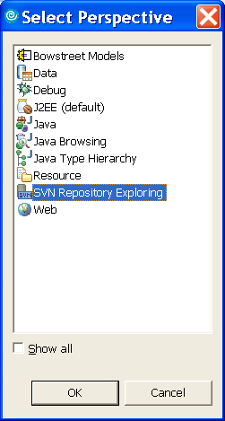
subclipse: SVN repository Perspective
Notes:
Choose Window -> Open Perspective -> Other …

Slide 28
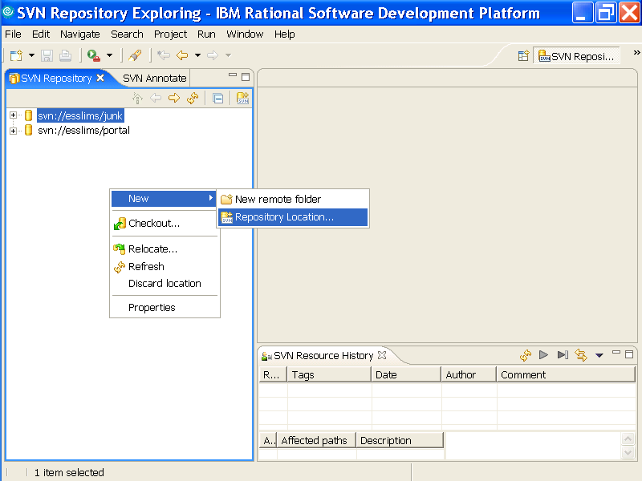
subclipse: add a repository

Slide 29
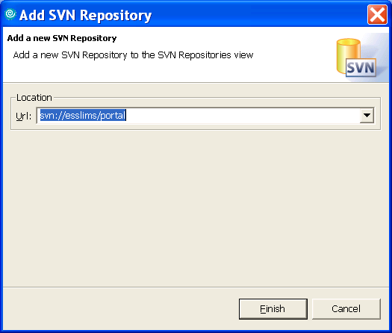
subclipse: portal URL

Slide 30
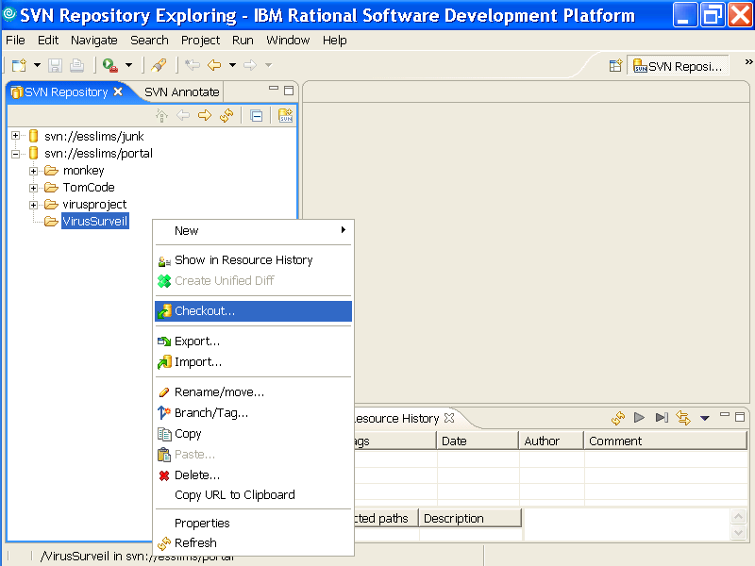
subclipse: checkout

Slide 31
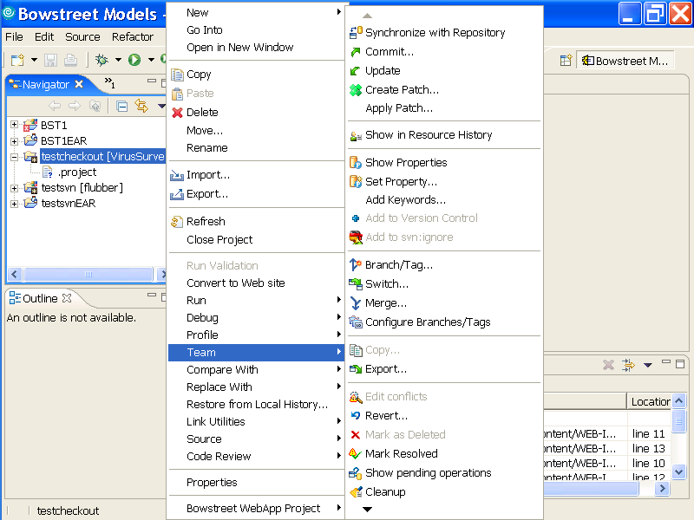
subclipse: team menu
Notes:
Alex recommends synchronize over update and commit. Synchronize is specific to the subclipse plugin; it’s not in TortoiseSVN or command line svn.

Slide 32
using the TortoiseSVN windows clients
browsing a repository
checking out an existing project
add windows explorer detail columns
obtain a lock
adding an object
update and check for conflicts
commit a changed tree

Slide 33
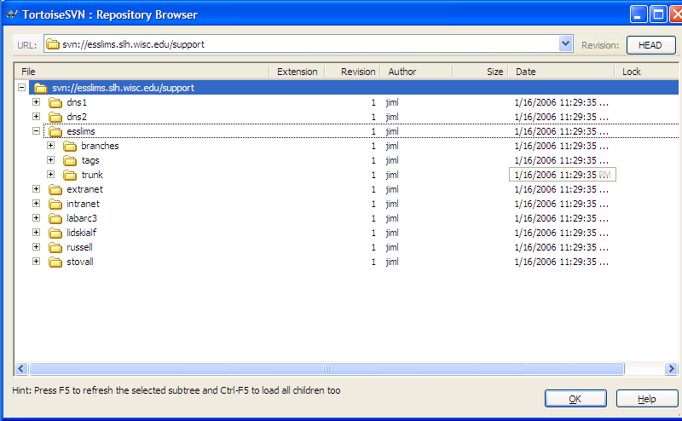
TortoiseSVN: repository browser

Slide 34
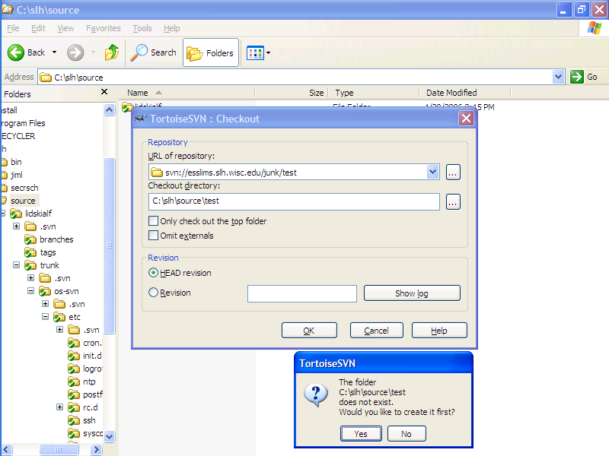
TortoiseSVN: check out
Notes:
Available from the command line, windows explorer context menu, and repository browser context menu

Slide 35
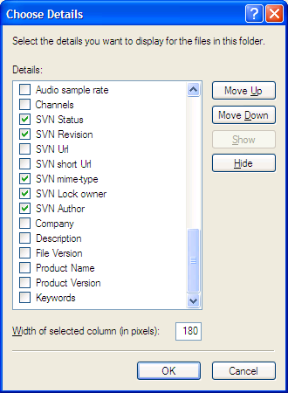
TortoiseSVN: expose SVN properties
Notes:
right click a windows explorer detail view heading and pick “more …”, then turn on stuff you want to see.

Slide 36
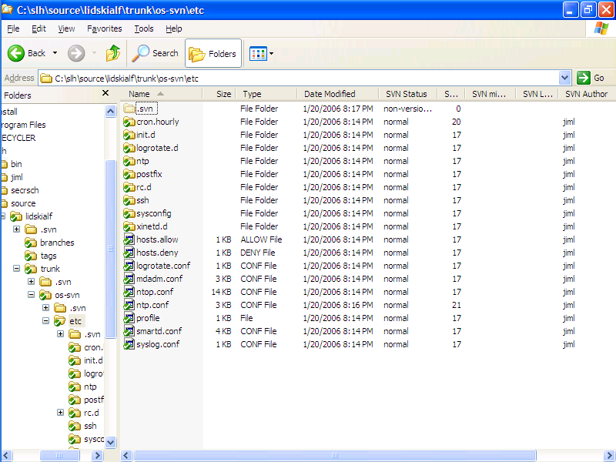
TortoiseSVN: windows explorer with SVN
Notes:
note the mixture of revision numbers – this view shows the last commit which changed something.
Also note the visual feedback – the icons have overlays

Slide 37
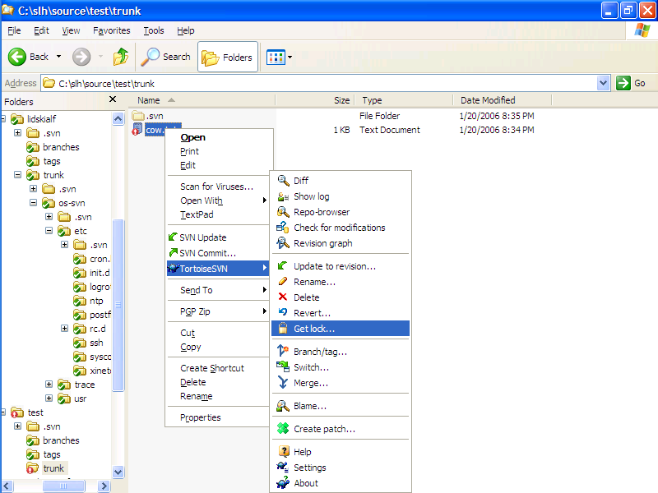
TortoiseSVN: context menu

Slide 38
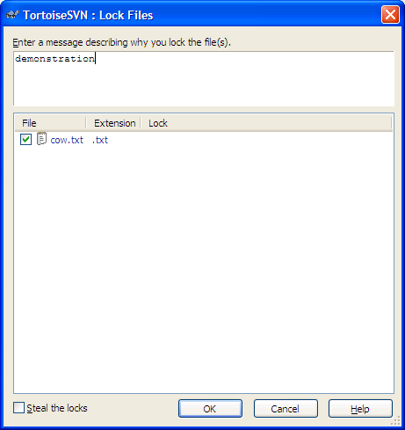
TortoiseSVN: request a lock

Slide 39
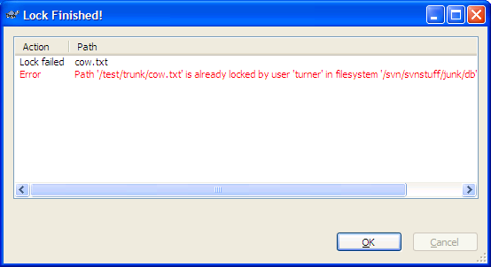
TortoiseSVN: someone else has it locked
Notes:
back up and point out the steal lock checkbox

Slide 40
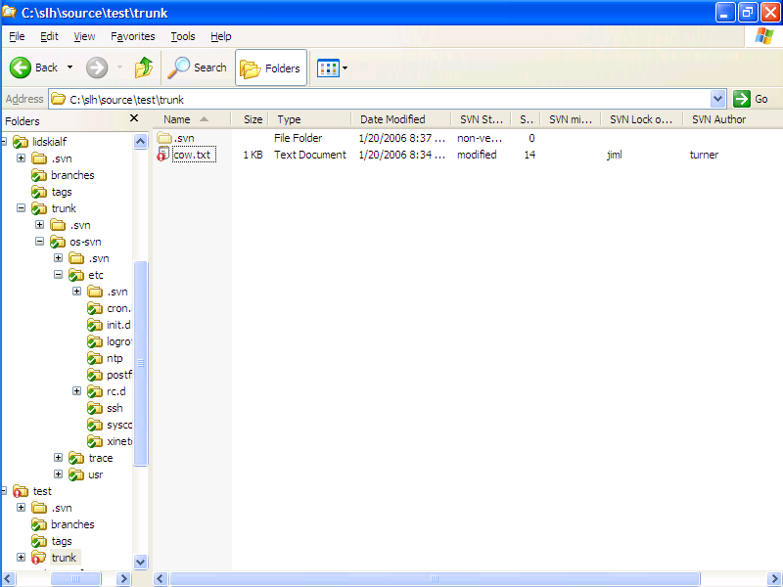
TortoiseSVN: locked and modified
Notes:
note that the file icon and the tree hierarchy (left pane) parent directories show modifications

Slide 41
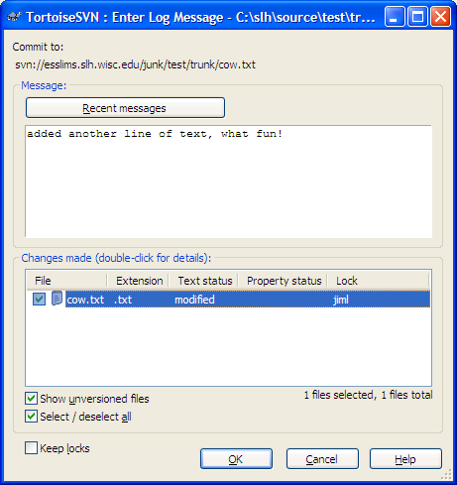
TortoiseSVN: commit dialog
Notes:
defaults are: include whole checked out tree, release all locks. You can change that.
Recent message button recalls text of previous commit log entries.
double clicking an item in the lower pane brings up the merge tool
put really good log messages in!!!

Slide 42
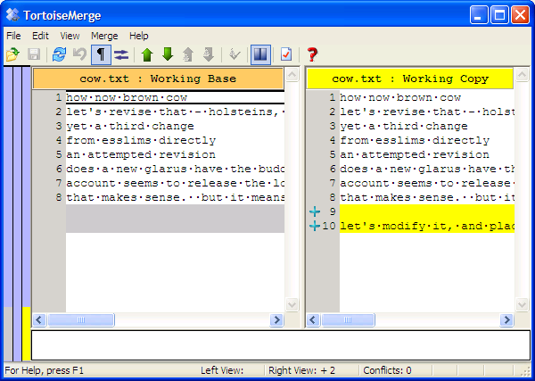
TortoiseSVN: merge tool
Notes:
This is the built-in merge tool in display. You can also have TortoiseSVN use external tools such as beyond compare for comparisons and textpad for editing.
If you were resolving a conflict, you have a 3-way display of the base version, your working copy, and buttons to step through changes and pick which ones survive into the resolved output.

Slide 43
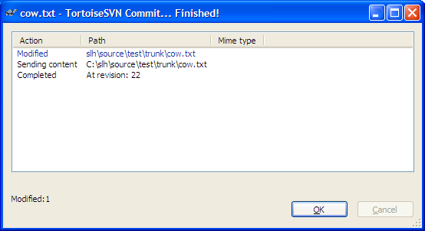
TortoiseSVN: commit feedback

Slide 44
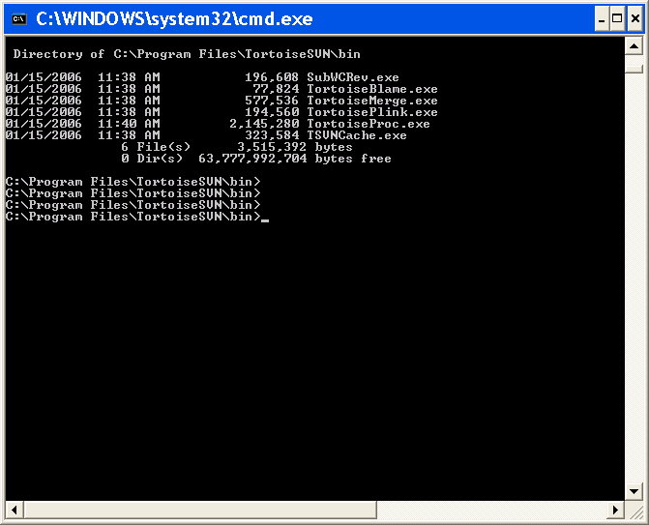
TortoiseSVN: command line
TortoiseSVN: commit feedback
Notes:
You can run TortoiseProc.exe and the other tools with command line arguments to script subversion client actions, either fully specified or with GUI dialogues. See appendix B in the TortoiseSVN book for details.

Slide 45
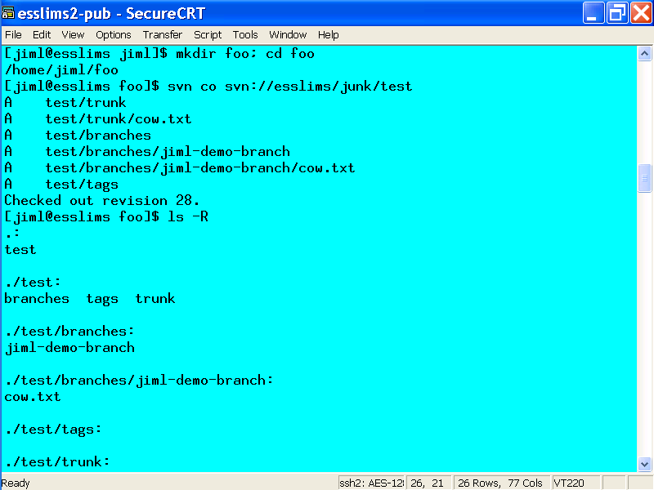
svn: command line client

Slide 46
svn: command line 2
browse in a repository
  svn ls svn://esslims/ -R
import a project
  mkdir –p foo/myproject/{trunk,tags,branches}
  svn import foo svn://esslims/junk –m “project checkin message’
check out a project
  rm –rf foo; mkdir foo; cd foo
  svn co svn://esslims/junk/myproject
add a file
  svn add newfile.c
commit changes
  export EDITOR=vi; svn ci

Slide 47
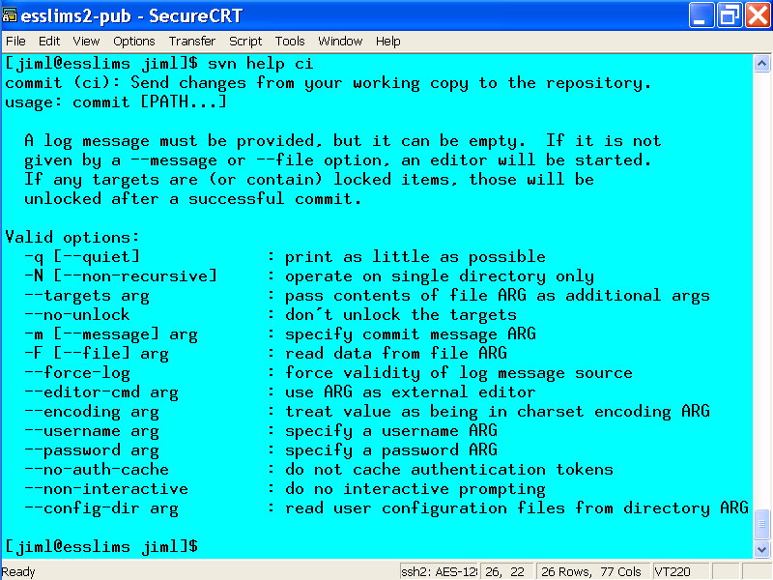
svn: command line help
Notes:
note that co is short for check-out, and ci for check-in. co is not commit. Think RCS and CVS on the abbreviations.

Slide 48
generating password material
#!/bin/bash
# argument 1 - how many runs, argument 2 - infix text, argument 3 - crypt salt
# default is subversion
if [[ $# -ge 3 ]]; then
count=$1; infix=$2; salt=$3
else
count=3; infix=“Your Infix Here“; salt=“ZZ"
fi
let k=0
while [[ $k -lt $count ]]; do
(date; echo "$infix $k") |
sha1sum |
fold -c -w5 |
grep -v -e ' -' |
perl -ne 'print crypt($_,"'"$salt"'"),"\n";' |
cut -c3-
let k=$k+1
done

